Slide 1
Art by Micaela Marie

Slide 2
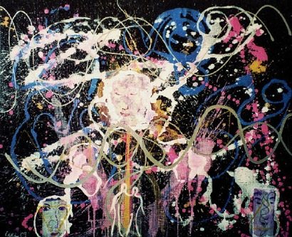
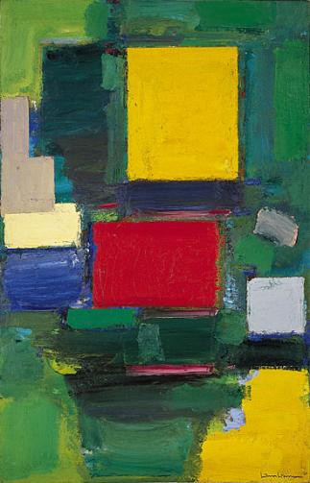
Crystal
Zigzag Zimzum DNA
Ulrich Osterloh
52.8x62.8 inches
Acrylic on polymer
2003
Two Faced
Micaela Stanly
1.8x1.4 feet
Acrylic on hard board
September 2011
The Gate
Hans Hoffman
75 x 48.5 inches
Oil on canvas
1959-1960

Slide 3
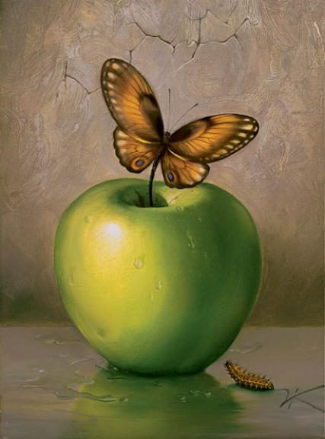
Sacred Vessel
Landscape With Butterflies
Salvador Dali
Size Unknown
Oil on canvas
1956
Unconditional
Micaela Stanly
x
Acrylic paint on clay
December 2011
Green Apple
Vladimir Kush
13x9.5 inches
Paint
1978

Slide 4
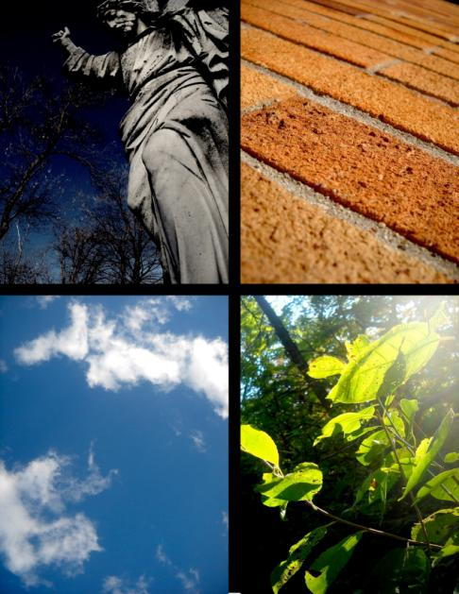
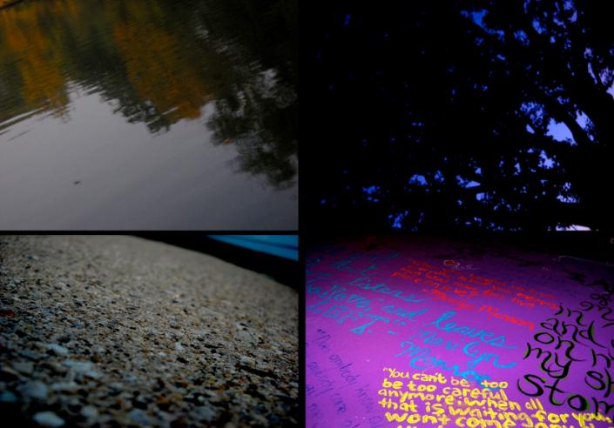
Holga

Slide 5
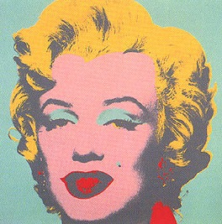
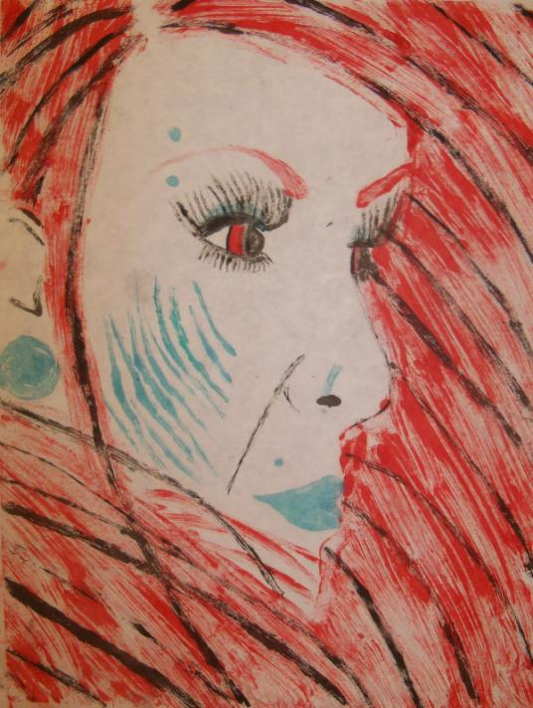
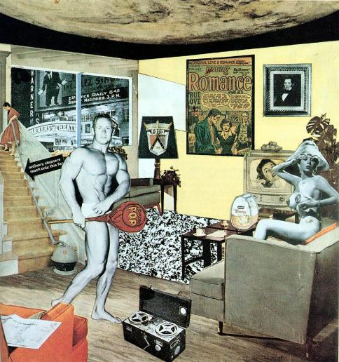
Mono print
Marilyn Monroe 23
Andy Warhol
36x36 inches
Screen print on white paper
1967
Just what is it that makes today's homes so different, so appealing?
Richard Hamilton
10.25x9.75 inches
Collage
1956
The Perception of Perfection
Micaela Stanly
12x8 inches
Oil paint on paper
December 2011
Marilyn Monroe 31
Andy Warhol
36x36 inches
Screen print on white paper
1967

Slide 6
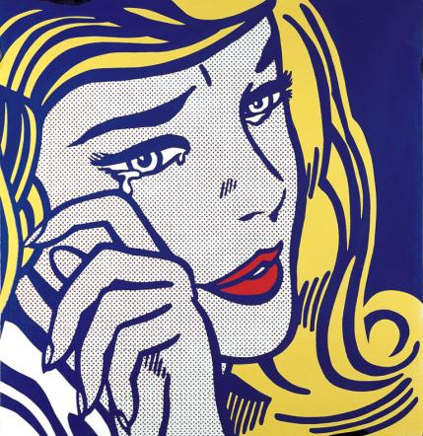
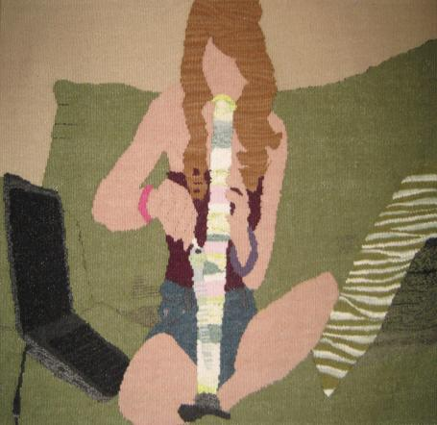
Block print
Crying Girl
Roy Lichtenstein
46 1/8 x 46 1/8 inches
Enamel on steel
1964
Am I a cool kid, now?
Micaela Stanly
8x12 inches
Ink on paper
November 2011
Webcam
Erin M. Riley
36x19 inches
Hand-dyed wool
2011

Slide 7
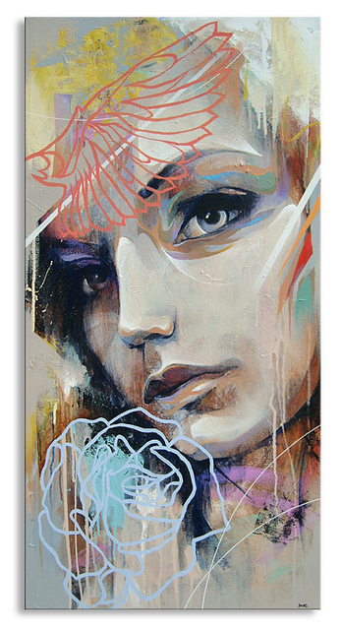
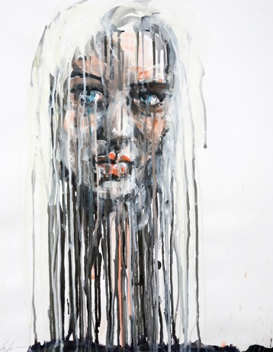
Artist & City In The Artist
Through the Eyes of the Beholder
Micaela Stanly
24x24 inches
Acrylic paint on canvas
November 2011
Self-Portrait #4
Chrissy Angliker
19x24 inches
Acrylic and Ink on canvas
2009
Tainted Perfection
Danny O’Conner
40x20 inches
Mixed media
2010

Slide 8
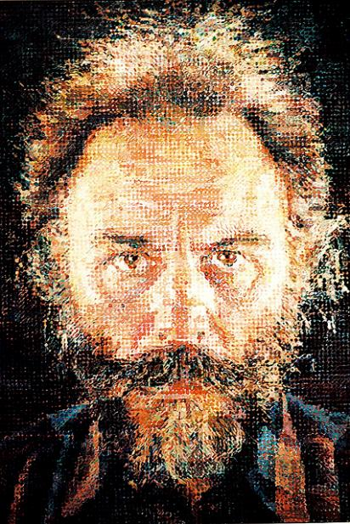
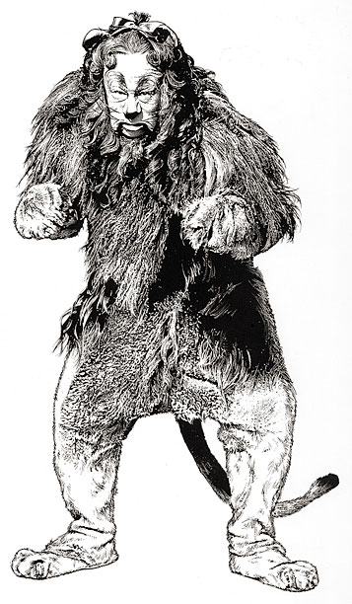
4x4 Self Portrait
Chuck Close
Lucas
100x84 inches
Oil and graphite on canvas
1987
Micaela Stanly
Perfectly Flawed
4ft by 4ft
Acrylic on canvas
February 2012
Randy Glass
Cowardly Lion
Size Unknown
Ink on paper
Date Unknown

Slide 9
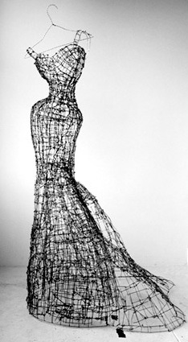
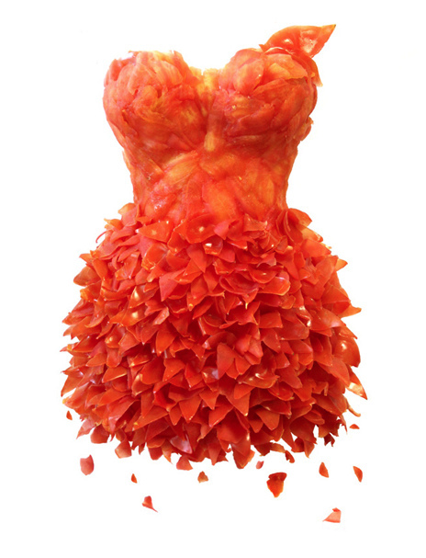
Found Object
Leigh Pennebaker
Madeline
Size unknown
Wire sculpture
Date Unknown
Micaela Stanly
Strength Through Belief
1.5x2.5 feet
Found Object
February 2012
Yeonju Sung
Tomato Dress
Size Unknown
Sculpture
January 2011

Slide 10
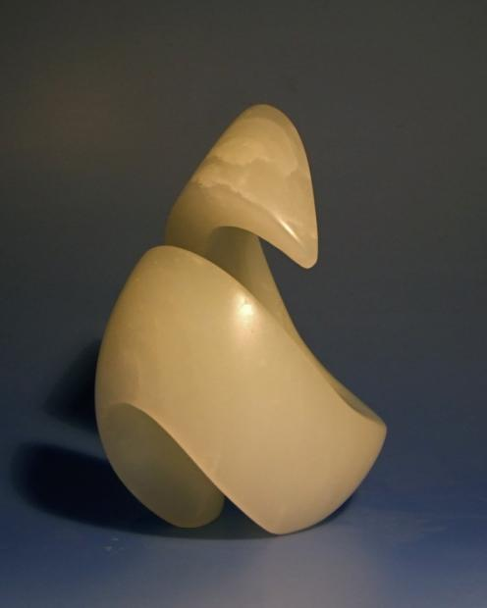
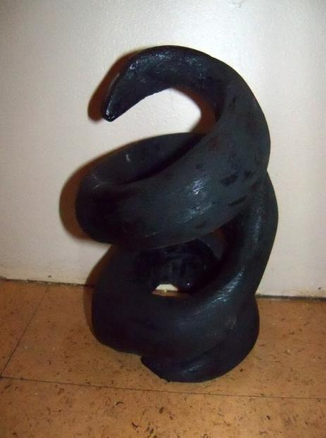
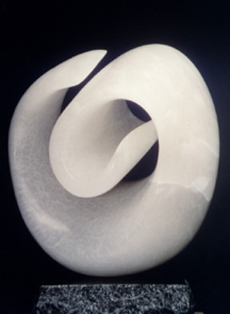
Abstract Organic Form
Peel
David Ritter
12cm x 12 cm
White soapstone
Date Unknown
Demonic
Micaela Stanly
1 ft x 6 inches
Plaster sculpture
April 2012
Embryo
Michael Cohen
18x12x12 inches
Italian Alabaster
1985

Slide 11
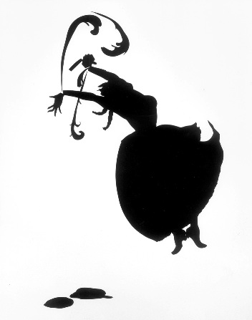
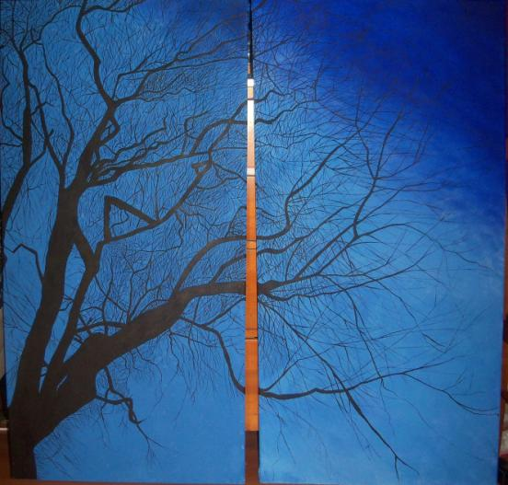
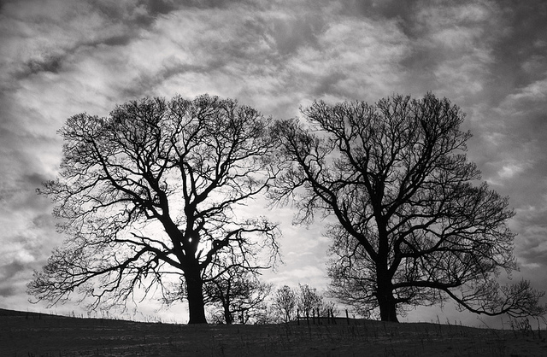
Photography Based Painting
Cut
Kara Walker
88x54 inches
Cut paper on wall
1998
Strength Through Determination
Micaela Stanly
4ft x 4ft
Acrylic on canvas
April 2012
Untitled
Nadia Isakova
Size unknown
Photo
November 2010

